Slide 1
Event management dashboard
DEVAN GAONKAR
1DT21IS047

Slide 2
Technology Stack
HTML
CSS
JAVASCRIPT
MYSQL
PYTHON

Slide 3
Functionalities
1. Event Management API:
Create an Event
Get all Events
Update an Event
Delete an Event
2. Attendee Management API:
Add an Attendee
Get all Attendees
Delete an Attendee\
3. Task Management API:
Create a Task
Get Tasks for an Event
Update Task Status

Slide 4
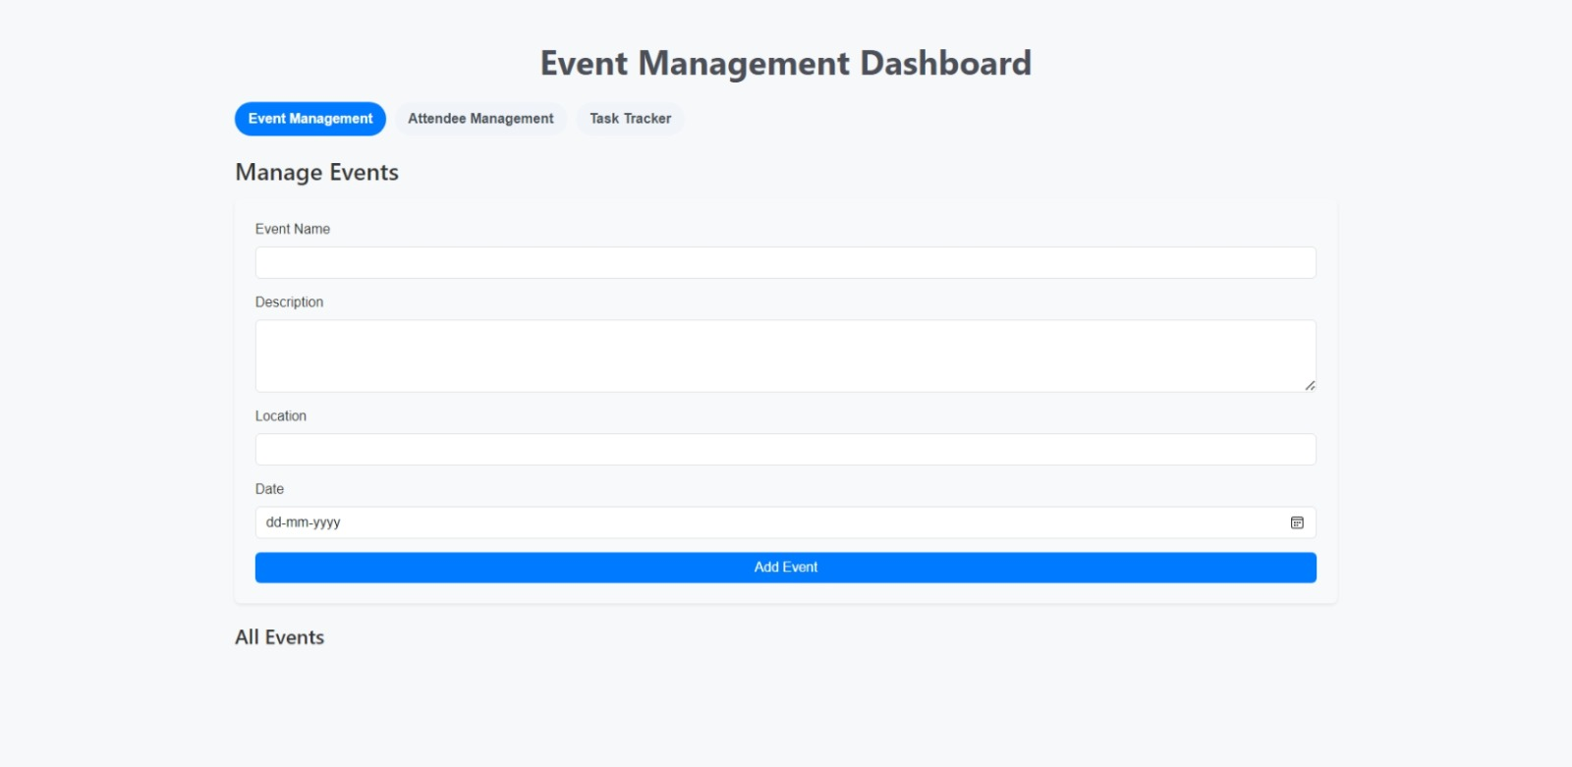
screenshots

Slide 5


Slide 6
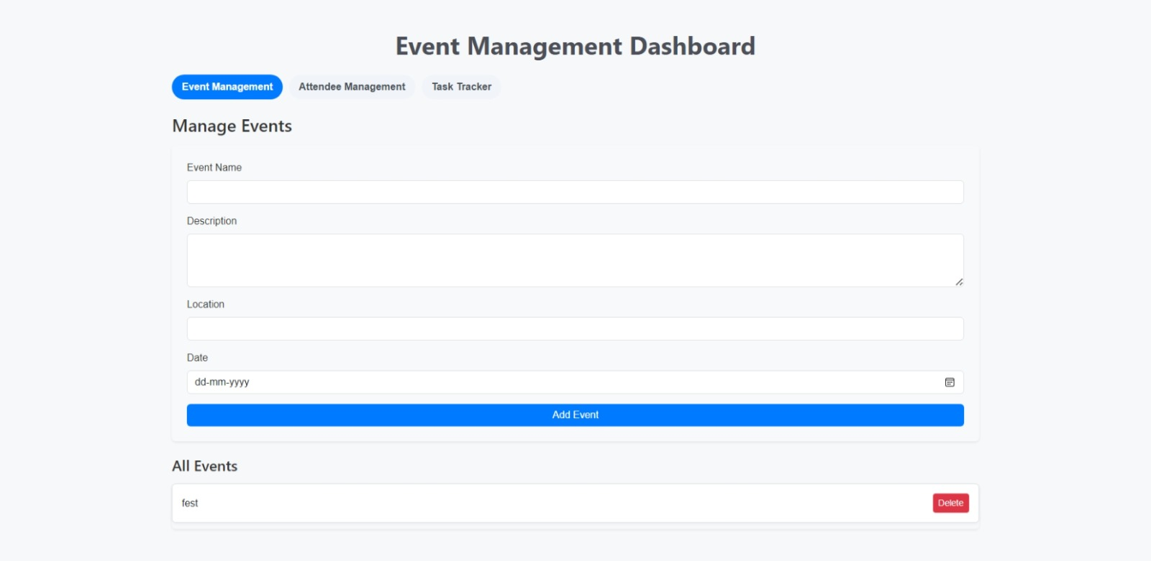
Event added successfully

Slide 7
